Slide 1

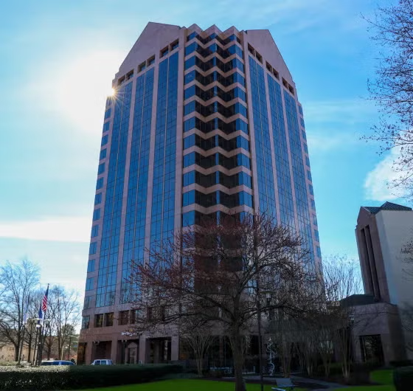
COCKY INVESTMENTS, INC
Presents Our Summary Investment Plan
To
Hitchcock & Company
April 23, 2026

Slide 2




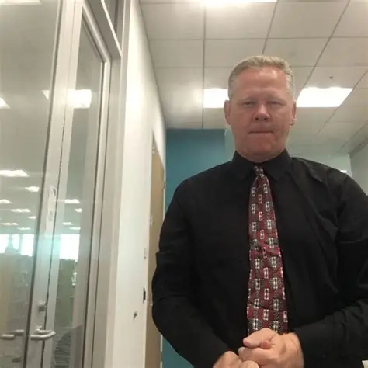

About us – Cocky investments (RYNE)
Cyrus
Partner – Autos
Strategic Investment Advice For the Weak Minded And Square
Our Proposal is based on Assets Held at Fidelity Inc as a Fiduciary Manager
We Used Github Repos, and Github.IO for Our Work

Slide 3
Customer Intake & Comments (RYNE)
Hitchcock and Company has solicited our opinion on how best to invest 50K dollars or roughly 25% of the company liquid assets into a new portfolio.
Our goal was to develop a strategic plan across 4 segments which we believe are the best opportunities for growth along with a traditional investment in Global Bond Funds for the Balance in Sovereign Debt and REITS which offer by law high dividend returns in equal amounts.
Our goal is to achieve a safe 4% growth using standard high dividend stocks (over a 10+ years), with equity options to add the balance pushing yields over 10% per annum.
Our worst case model is 4% and our highest outcome is as high as 15% in some segments. Over 10 years and using the rule of 72, stock investments should double on the order of every 12 years, and likely significantly less time than that.
We are therefore seeking to invest at low load 50K of your monies, and hope you will give us an additional 50K dollars to invest next year after you know how we work.

Slide 4
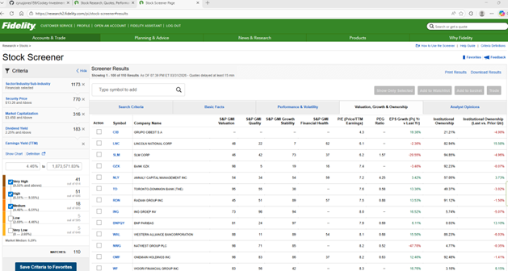
OUR PROCESS IN THIS PROJECT (RYNE)
Each of our Partners picked a segment… then we agreed on a basic safe portfolio process where we sought out high dividend stable stocks.
We started by looking at four segments for equities, along with bond, mutual, and REIT investments for the 5th.
We sought equities with at least 1B in market value, stocks under $100 making them liquid and affordable, and which had clear history of 10 years of equity information, and 10 years of dividends which were static or growing.
We eliminated very high priced stocks, those with low dividends, low or extremely high market caps, to lower the Beta(or Risk) of our projected portfolio. Additionally we used our own intuition by Partners who are experts in our segments to eliminate stocks or investments which have near term litigation, cloudy futures due to technology changes, and other risk factors. Some stocks annoyed us by lowering their dividends over time.
We sough to provide 10-20 stocks in each sector with a 10K dollar target allocation. This means each stock would give us about 5% of that amount trued up to full shares. The exact amounts attributed to the amount of cash we had to investment in Bond Funds, REITS, Mutual funds and stock funds. (Remaining 10K).
We used Fidelity investment tools to restrict the stocks using their comprehensive Wholesale tools available to Cocky Investments via contract.
We intend to hold your assets at Fidelity with the firm knowledge that it would be possible to terminate our contract through a legal process with no risk to your investment should you feel that we gave you bad advice.

Slide 5
Sector INFORMATION
SEGMENT PLANNING

Slide 6
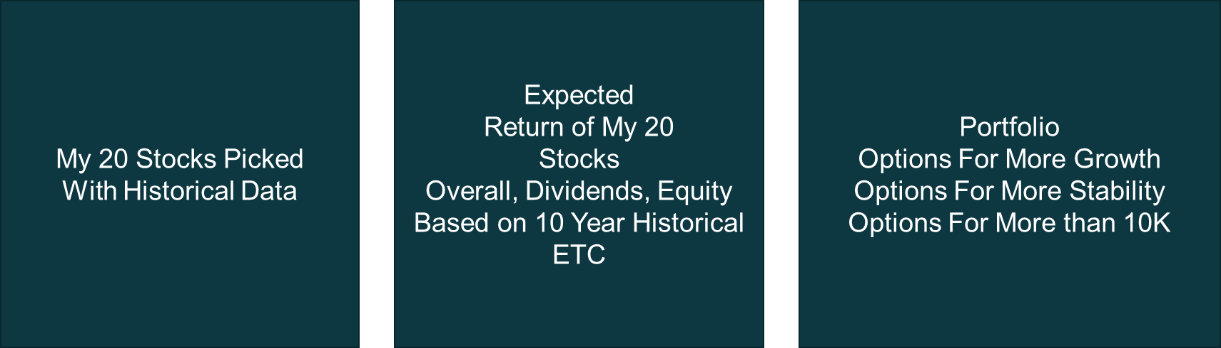
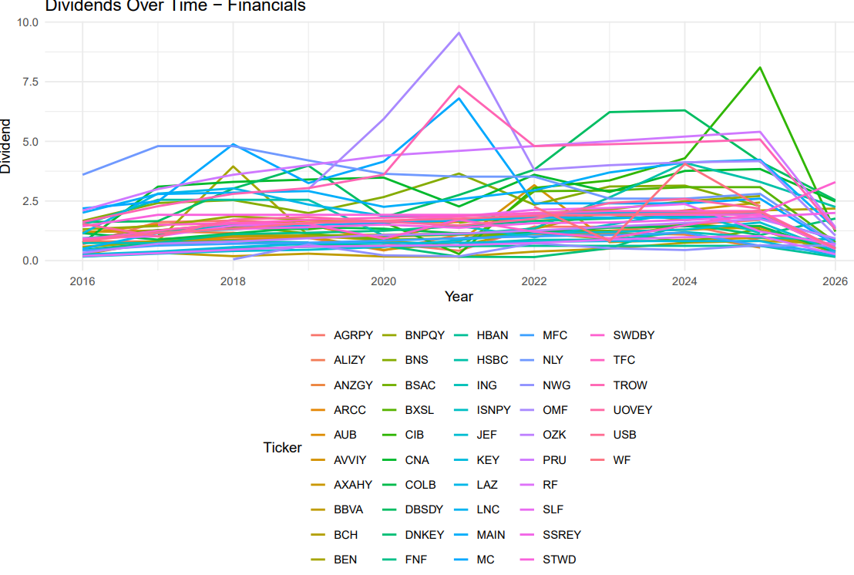
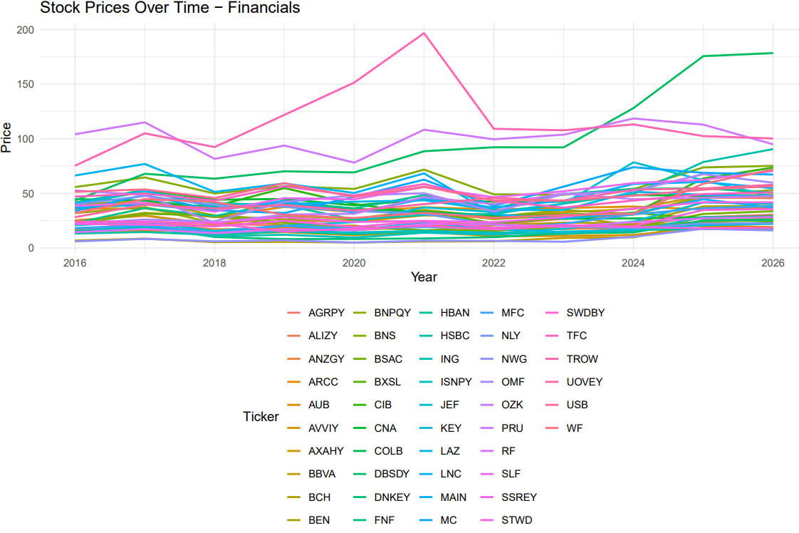
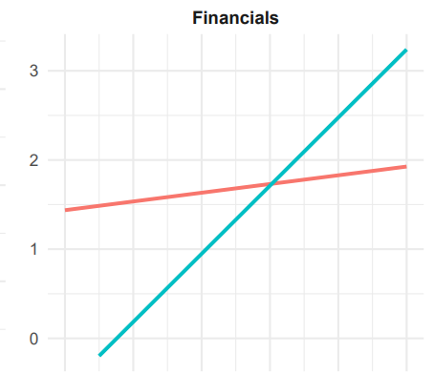
FINANcIALS (john)

Slide 7
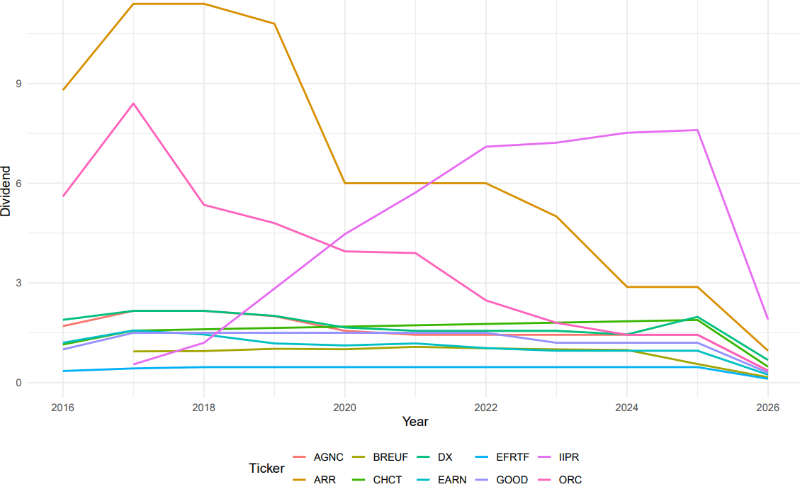
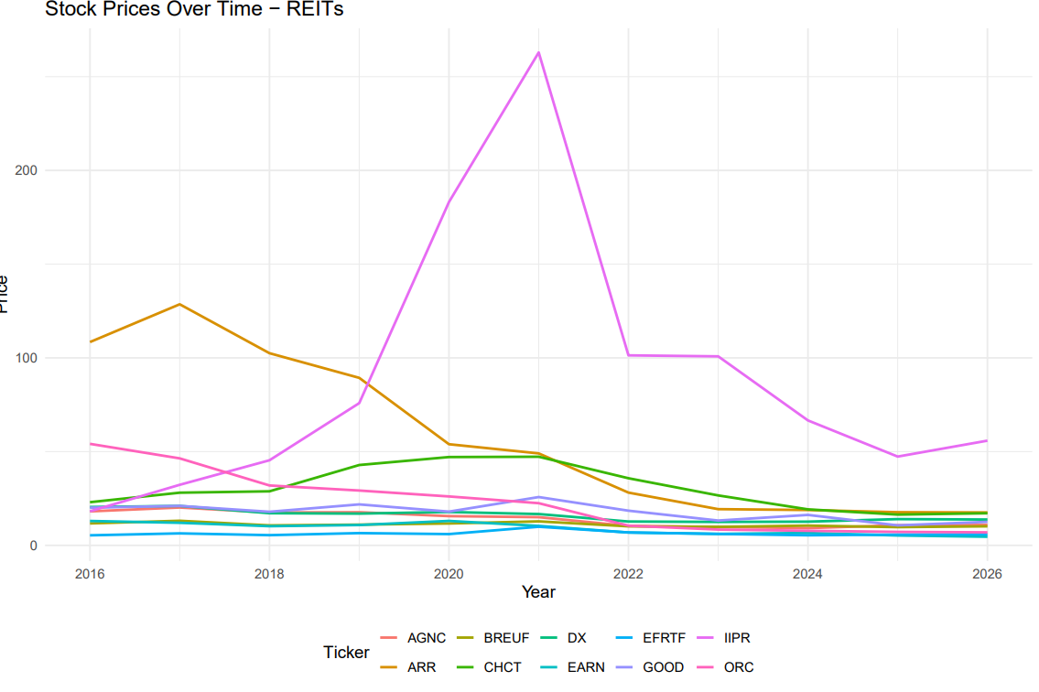
BALANCES & BOND/REIT INVESTMENTS (JOHN)
The Reits I choose were not from Fidelity… will Fix….

Slide 8
Health (Ryne)
My 20 Stocks Picked
With Historical Data
Expected
Return of My 20
Stocks
Overall, Dividends, Equity
Based on 10 Year Historical
ETC
Portfolio
Options For More Growth
Options For More Stability
Options For More than 10K
* Comments about restrictions decisions made on Invidiual Securities and why you steered away from specific investments for one reason or another? Comments on Your decisions for Dividend Yeilds vs Growth.

Slide 9
ENTERTAINMENT (Holden)

Slide 10
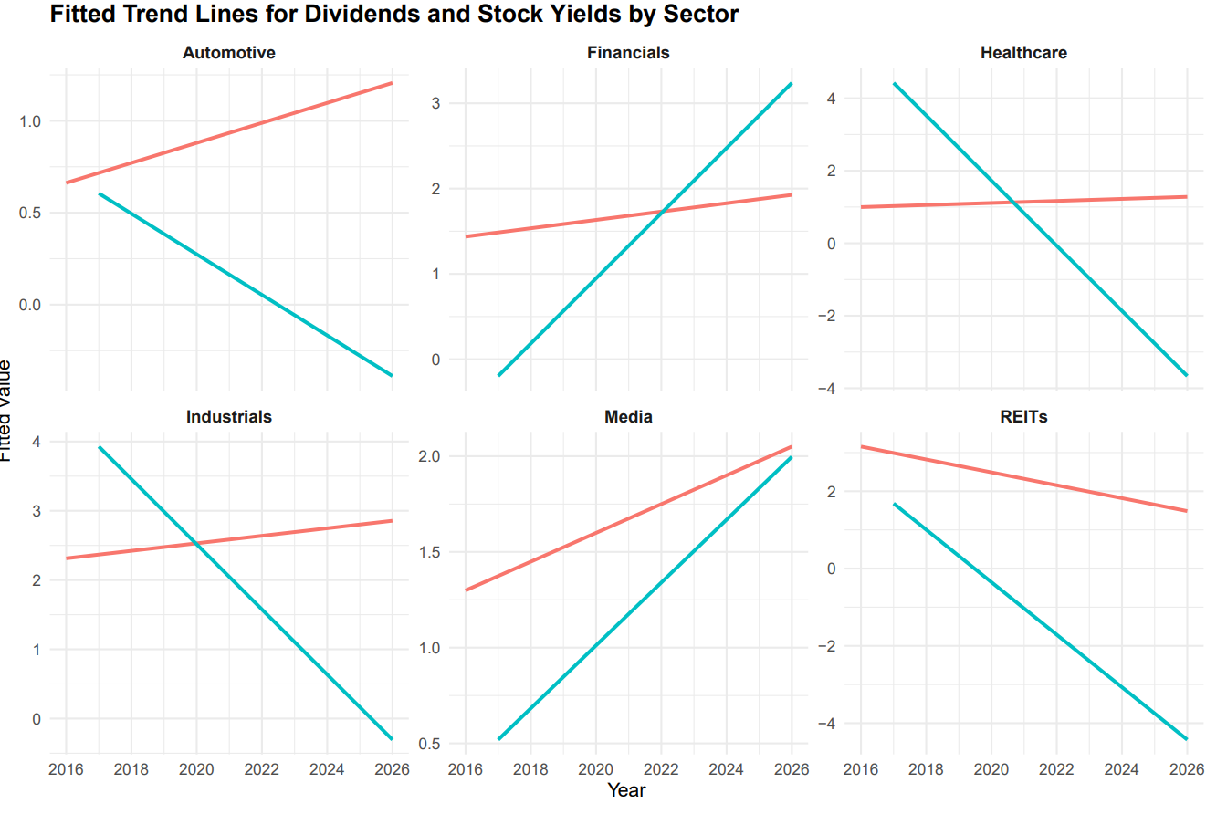
PORTFOLIO MODELING RESULTS BEFORE* (Holden)
Financials and Media did very well with our analysis….
Some of the data doesn’t appear to make sense from Yahoo… as the REITS in question all have 6-20% yields….
Care needs to be made to eliminate
*Expected Returns based on prior10 year history

Slide 11
PORTFOLIO MODELING RESULTS AFTER* (Holden)
Financials and Media did very well with our analysis….
Some of the data doesn’t appear to make sense from Yahoo… as the REITS in question all have 6-20% yields….
Care needs to be made to eliminate
*Manual Human Screen Pared Back Picks

Slide 12
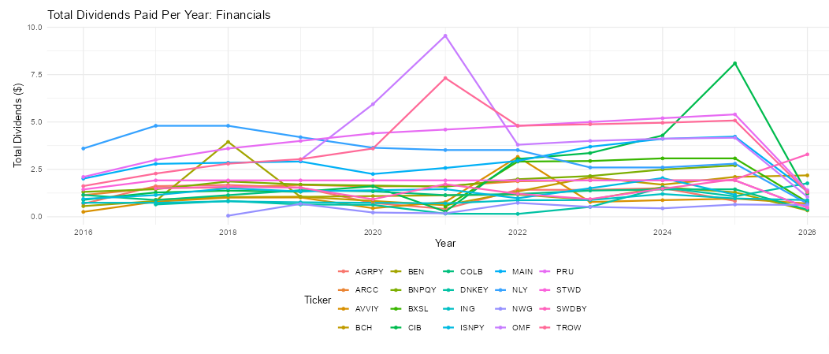
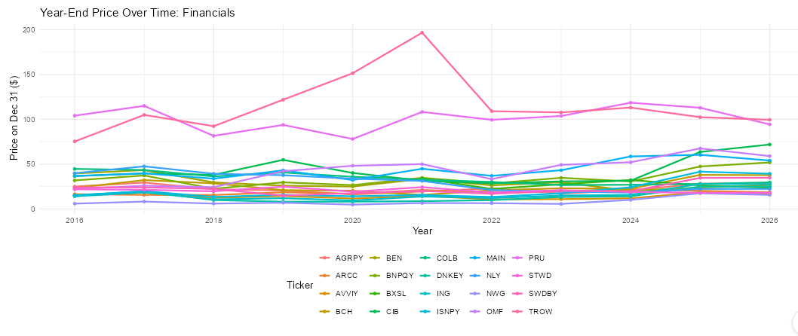
AUTOMOTIVE (CYRUS)
Overview of the Top 20 stock options showing primarily gradual payouts with a few high-yield outliers.
Year-Over-Year prices at the end of the year
show cyclical behaviors among tickers
alongside a steady increase among these
earners.

Slide 13
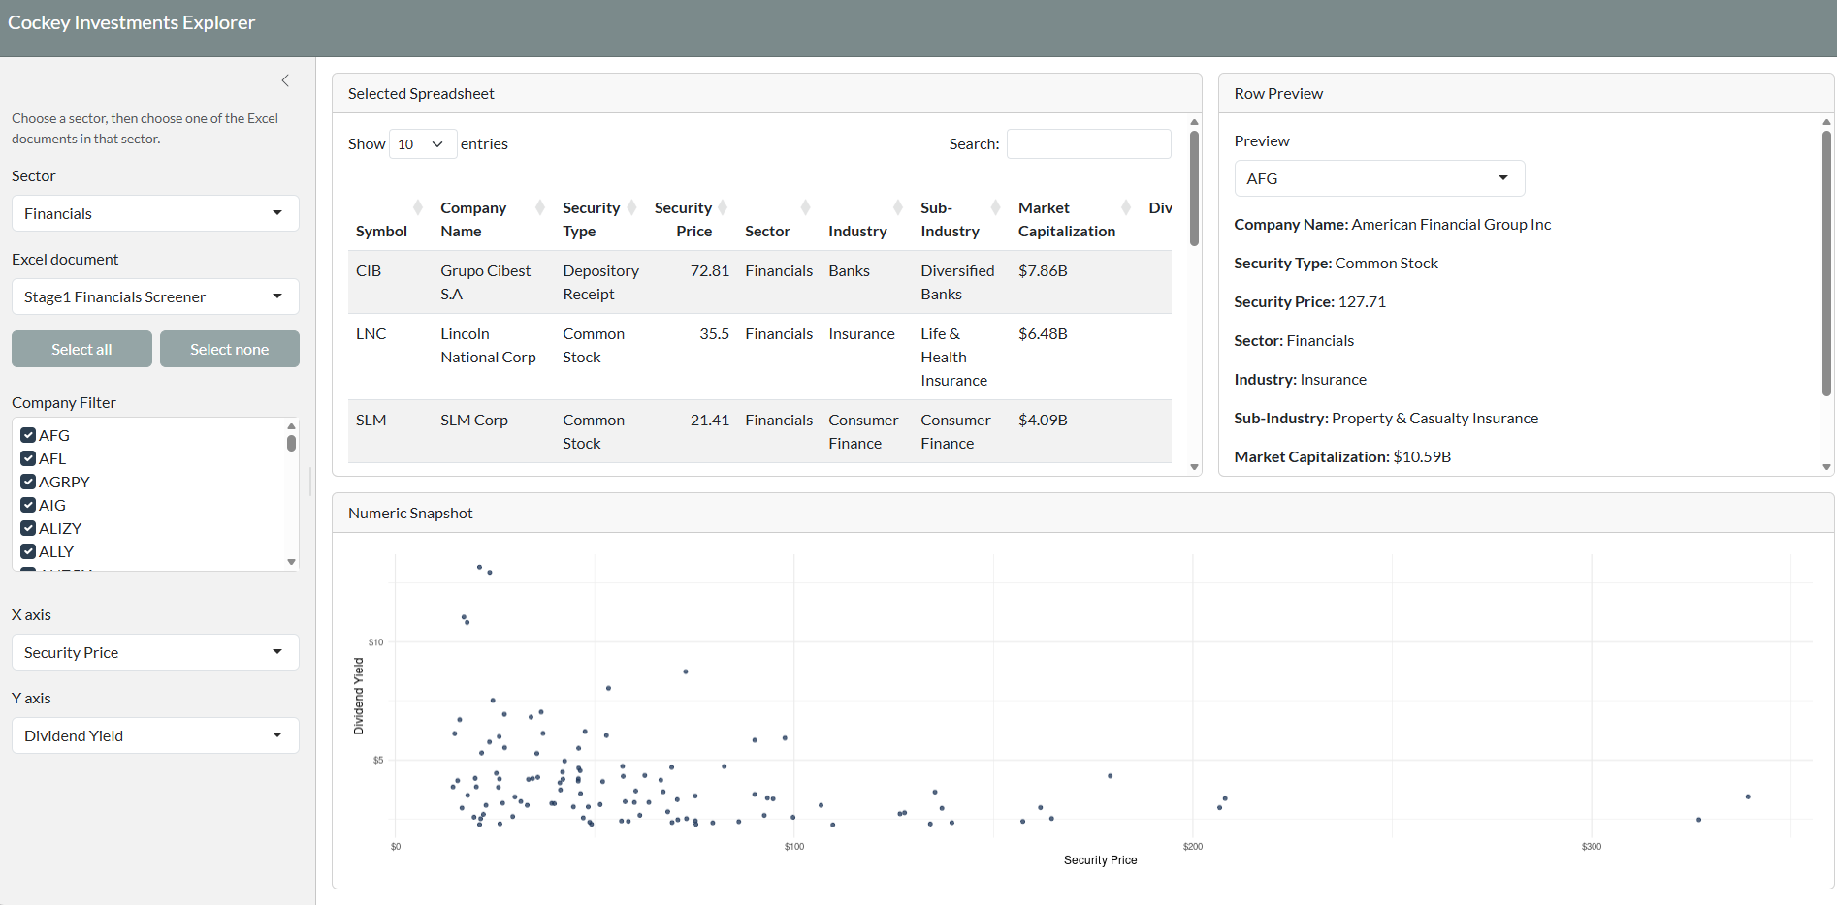
Customer Tools – PLANNING (CYRUS)
Quick Video on Shiny App (2 mins)

Slide 14
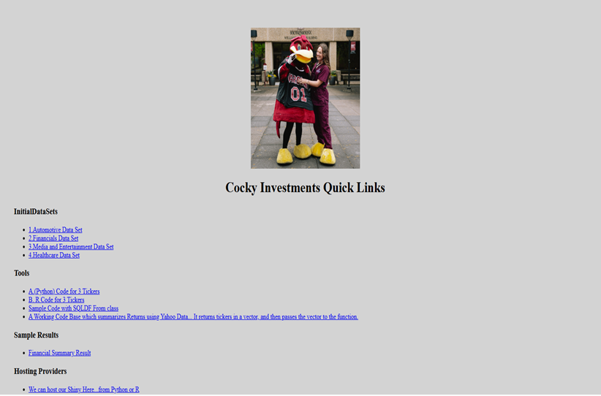
Customer Tools – GENERIC USES(CYRUS)
Team Web Portal & Other HTML Centric Tools
Quick Video on Fidelity Use Cases (2mins)
Time Permitting.

Slide 15
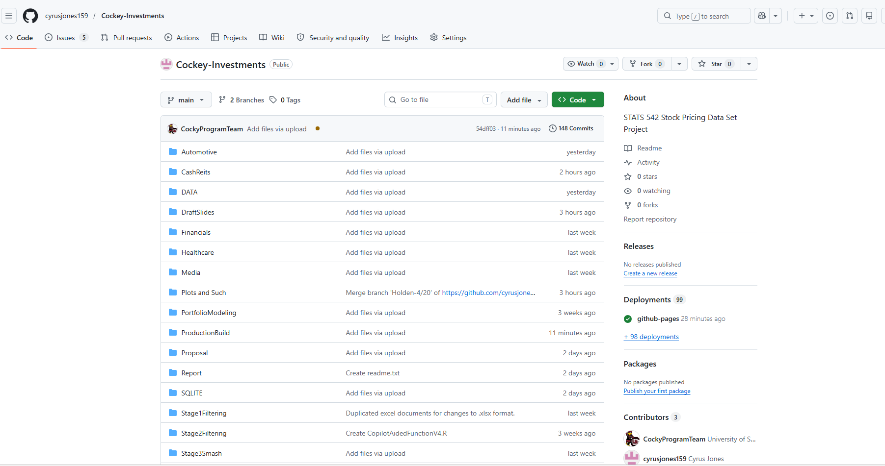
Wrap up (holden)
Github
Our Team
R Source Code
Database Interactions
ETC
Source Code Submission
Report Submission

Slide 16
QUESTIONS?
Name
Title
Email
Social

